Slide 1
WEATHER ANALYSIS DURING WORLD WAR 2
by
Ankita Burde
Under the guidance of
Mr. P. Bose (Top Mentor)

Slide 2
Overview
Context - While exploring the Aerial Bombing Operations of World War II and recalling that the D-Day landings were nearly postponed due to poor weather, I sought out weather reports from the period to compare with missions in the bombing operations dataset.
Content - The dataset contains information on weather conditions recorded on each day at various weather stations around the world. Information includes precipitation, snowfall, temperatures, wind speed and whether the day included thunderstorms or other poor weather conditions.

Slide 3
Acknowledgements - The data are taken from the United States National Oceanic and Atmospheric Administration - National Centres for Environmental Information website: https://www.ncdc.noaa.gov/dataaccess/land-based-station-data/land-based-datasets/world-war-ii-era-data
Inspiration - This dataset is mostly to assist with the analysis of the Aerial Bombing Operations dataset.
Goal - The Goal or the objective of this study is to predict the max and min temp based on several parameters and represent it in a visual form.

Slide 4
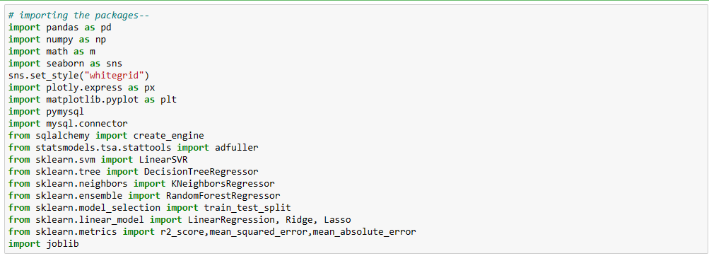
2. Loading the Dataset in Jupyter Notebook

Slide 5
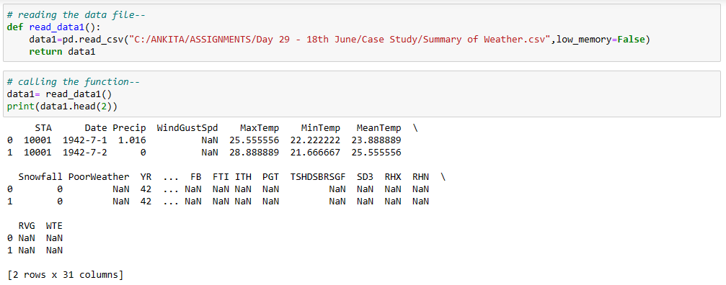
Reading 1st Dataset

Slide 6
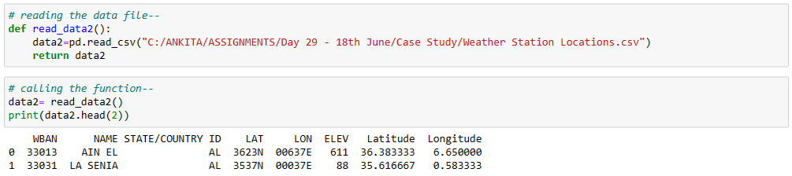
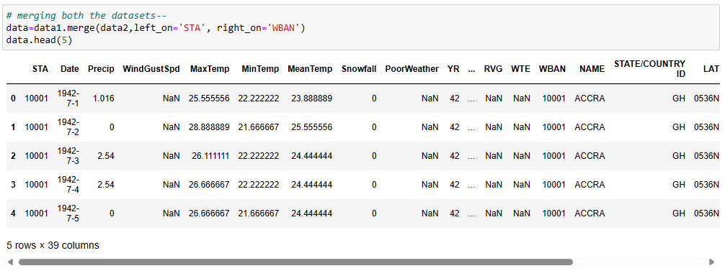
Reading 2nd Dataset
Merging both the Datasets

Slide 7
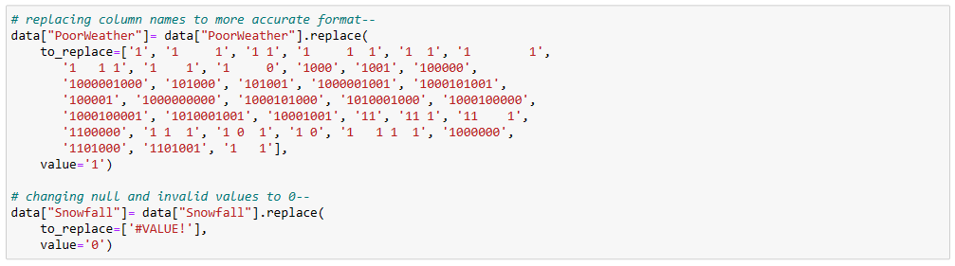
Data Cleaning & Data Type Conversions
Dropping the columns

Slide 8
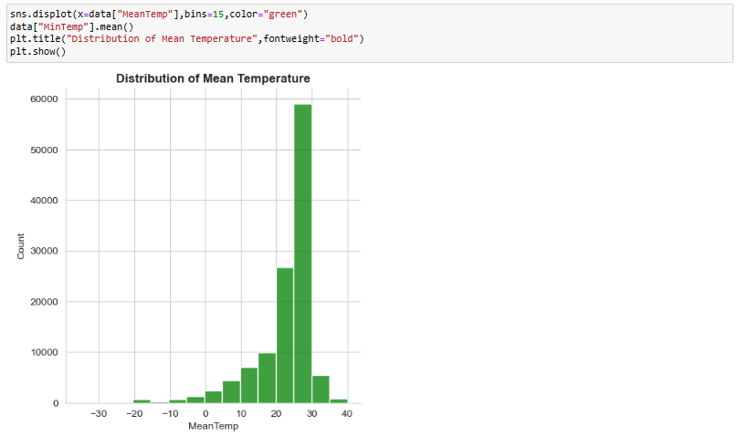
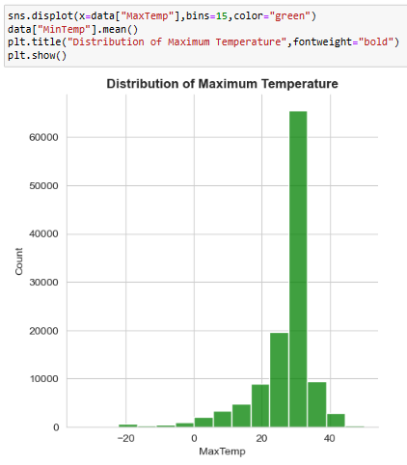
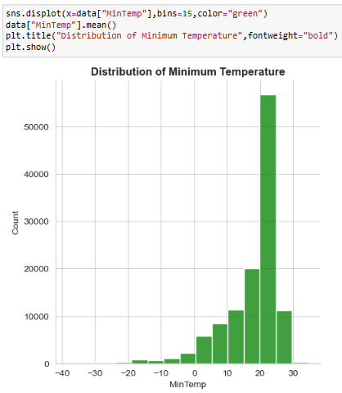
Exploratory Data Analysis

Slide 9
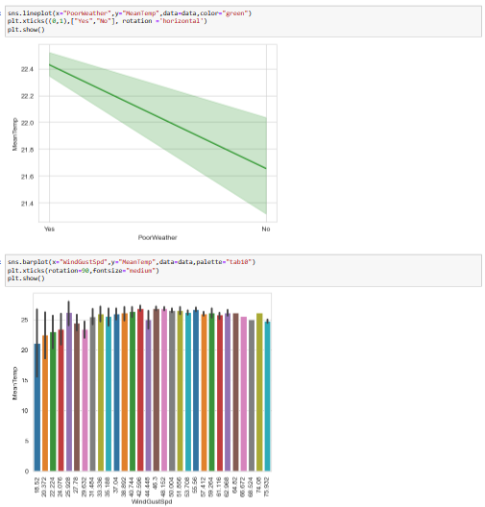
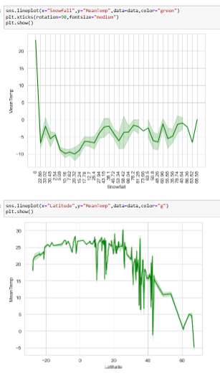
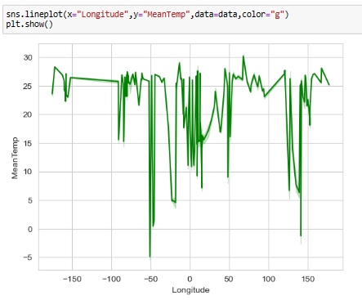

Slide 10
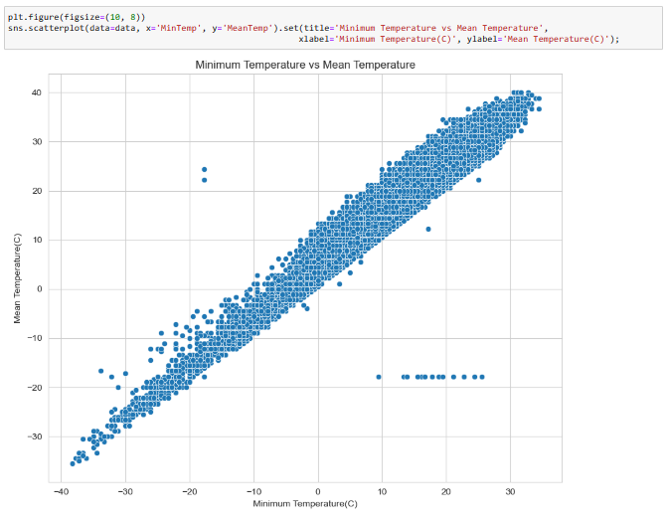
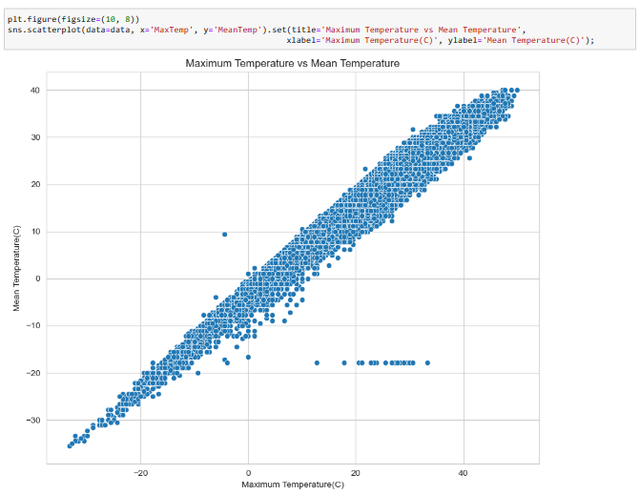

Slide 11
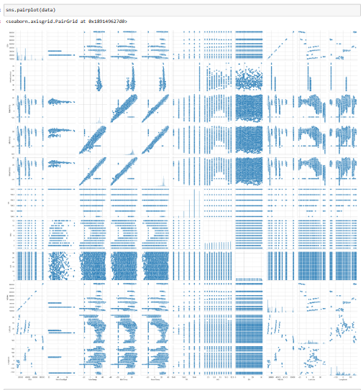

Slide 12
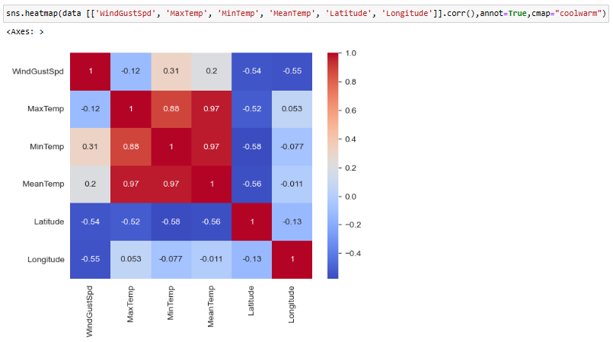

Slide 13
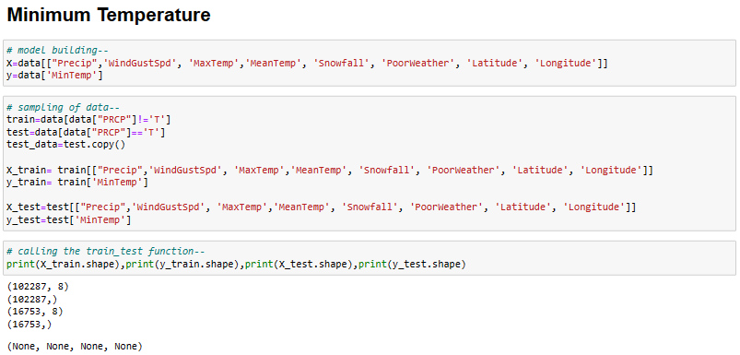
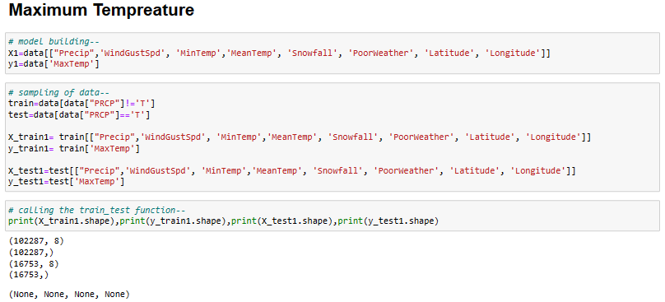

Slide 14
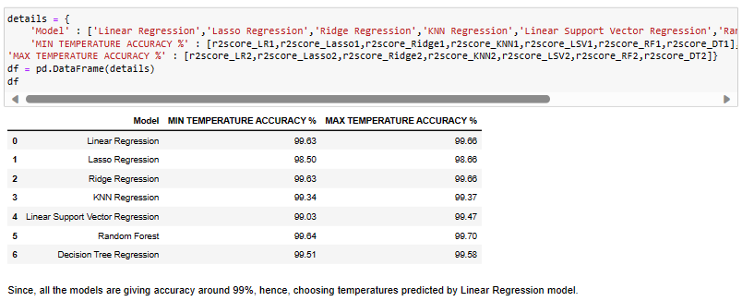
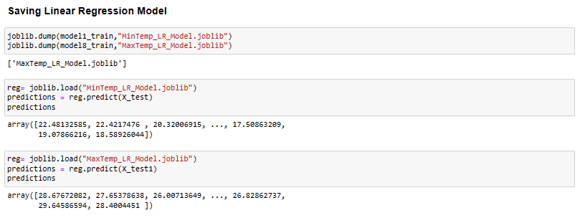

Slide 15
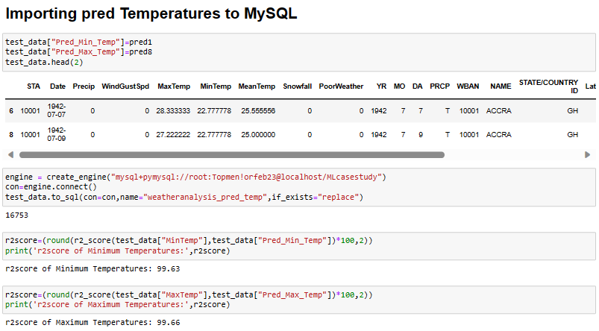
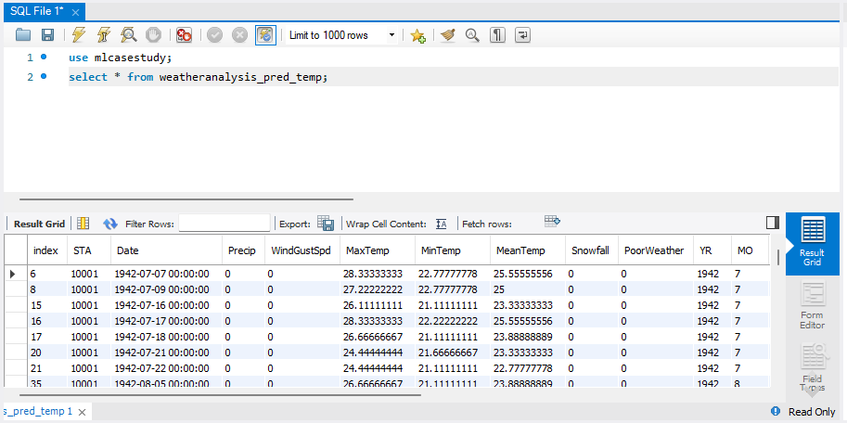

Slide 16
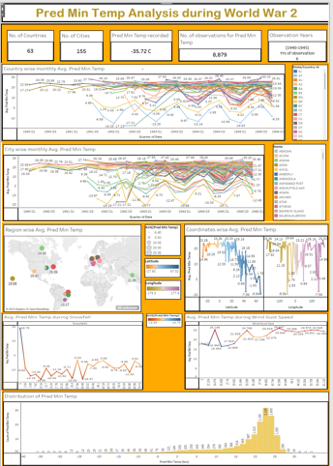
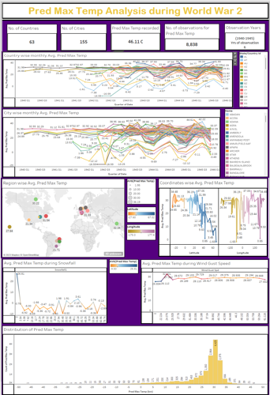
3. Tableau Dashboard

Slide 17
Thank You!

